Slide 1
Garden Cities
Planning Theories of Ebenzer Howard
Introduction
Important Terms/ Concepts
The Garden City
Letchworth, Welwyn and Greater London Plan
Instructor:Syed Arif Hussain
Department of City & Regional Planning
University of Engineering & Technology, Lahore
September 12, 2015

Slide 2
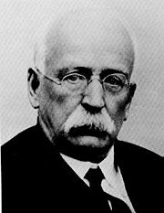
INTRODUCTION
Ebenzer Howard (1850 - 1928) – the founder of Garden City Concept was primarily a farmer with little formal education.
Due to his shorthand writing knowledge, he succeeded to find a job with a firm who used to produce official parliamentary reports.

Slide 3
Introduction
That job provided Howard enough reading material regarding various social issues of the time which enabled him to develop certain thoughts and views.
In 1898, he produced his first book titled Tomorrow: A Peaceful Path to Real Reform proposing development of new towns of limited size, planned in advance, and surrounded by a permanent belt of agricultural land.

Slide 4
IMPORTANT TERMS/ CONCEPTS
The various terms introduced by Howard are as follows:
  Garden City: generally it is knows as ‘a city in a garden – that is surrounded by beautiful country’.
  In detail, it can be described as ‘a Garden City is a town designed for healthy living and industry; of a size that makes possible a full measure of social life, but not larger; surrounded by a rural belt’.

Slide 5
Important Terms/ Concepts
  Suburb is an outer part of a continuously built-up city, town or urban area, implying that it is not separated by intervening country land’.
  Satellite Town was referred to a garden city placed at a moderate distance from a large city, but physically separated from that city by a country belt.
  Country Belt/ Agricultural Belt/ Rural Belt is a stretch of countryside around and between towns, separating each from the others, and predominantly permanent farmland and parkland.

Slide 6
Important Terms/ Concepts
  Green Belt/ Park Belt is a narrow strip of parkland more or less encircling part of a built-up metropolitan or large urban area.

Slide 7
The Three Magnets
Howard described the impact of town and country on people as magnets because of their certain pull factors.
Further, he added that those areas have their drawbacks as well.
According to him, an area having the characteristics of town and country both will attract people more and thus termed as Town-Country Magnet.

Slide 8
The Garden City
Ebenzer Howard, presented the idea of the optimum size for towns and concluded with a cluster concept; a central city of 58,000 people surrounded by smaller ‘garden cities’ of 32,000 people each.
Permanent green space/ country belt separated the city and towns.
Rails and roads linked the city and towns, which had their own industries.

Slide 9
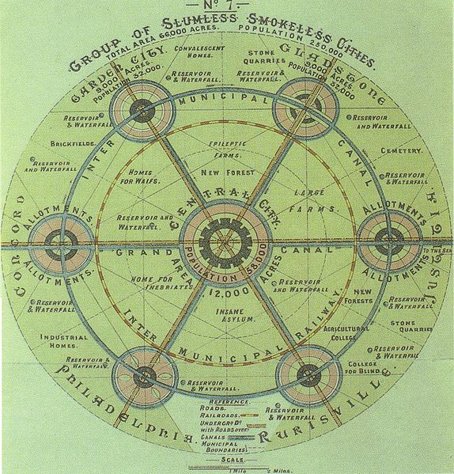
The original Garden City Concept by Ebenzer Howard; 1902

Slide 10
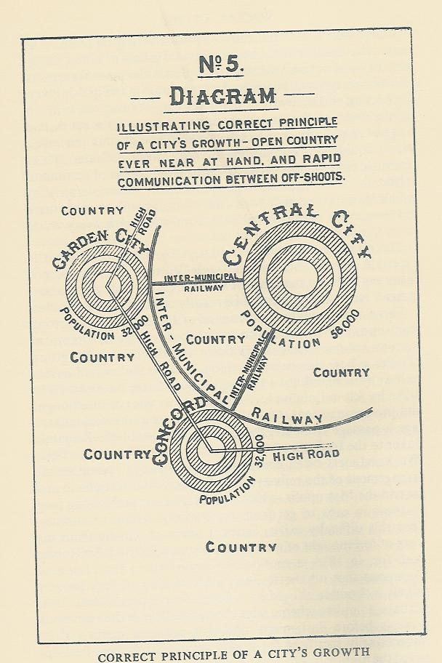
The original Garden City Concept by Ebenzer Howard; 1902

Slide 11
The Garden City
Schematic Diagram of Garden City.
Illustration of Central Part.

Slide 12
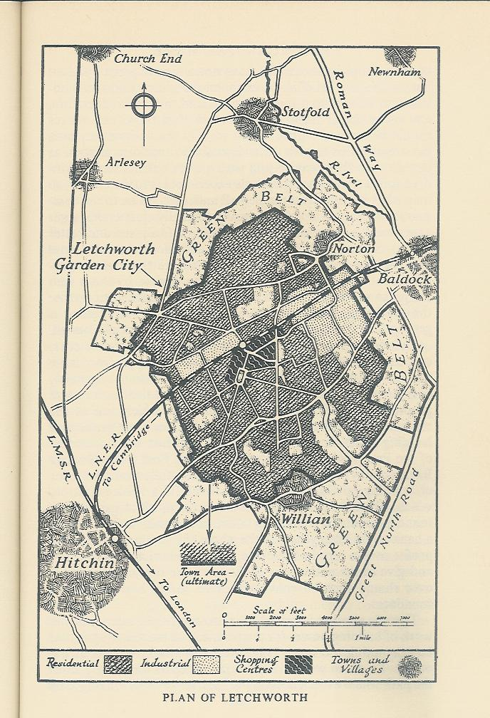
Letchworth-the first Garden City
In 1903, a rural site of 3,818 acres was acquired 35 miles from Central London, and the first garden city of Letchworth was initiated.

Slide 13
Letchworth-the first Garden City
In year 1974, Letchworth had a wide range of prosperous industries, a town of homes and gardens with ample open spaces and a spirited community life, virtually all its people found their employment locally, it was girdled by an inviolate agricultural belt.
Its health record was better than that of any other industrial town except the second Garden City of Welwyn.

Slide 14
Letchworth-the first Garden City
In year 1974, Letchworth had a wide range of prosperous industries, a town of homes and gardens with ample open spaces and a spirited community life, virtually all its people found their employment locally, it was girdled by an inviolate agricultural belt.
Its health record was better than that of any other industrial town except the second Garden City of Welwyn.

Slide 15
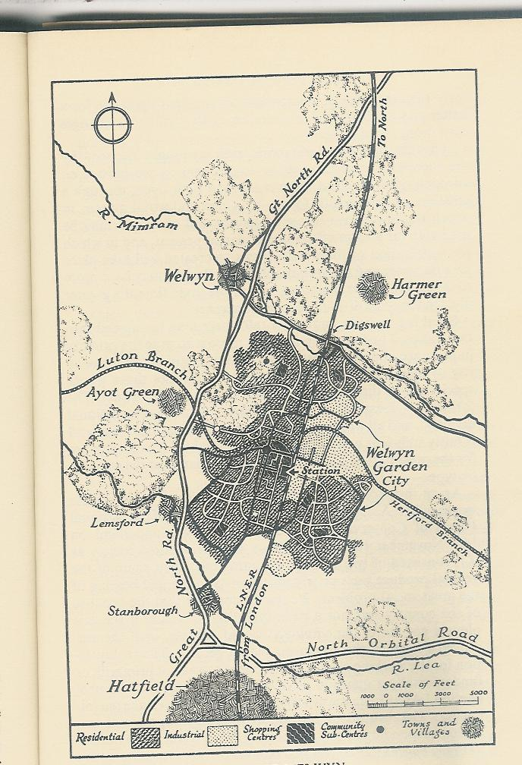
Welwyn-the second Garden City
The second garden city – Welwyn was the result of Howard’s personal initiative in 1919.

Slide 16
Welwyn-the second Garden City
Howard conducted interesting experiments by organizing shopping centers and factory area in Welwyn keeping in view the economics of large scale development.
Being nearer to London than Letchworth, it had a more proportion of residents who travel daily in to the Metropolis, but at least 85 per cent of its working population found their employment in the town (1974).

Slide 17
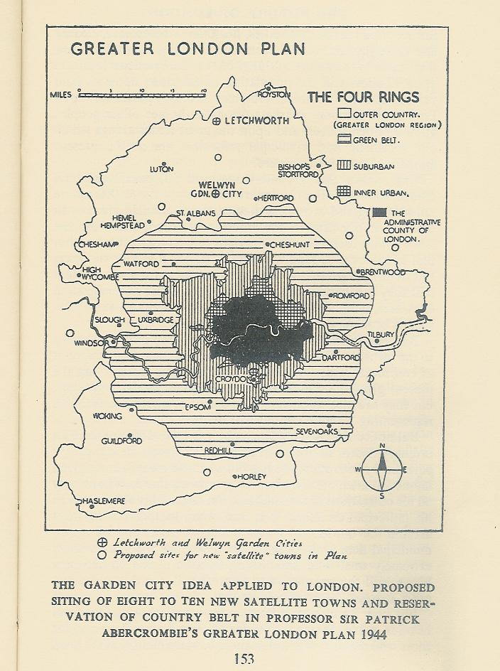
Greater London Plan; 1944

Slide 18
References
  Howard, Ebenzer ‘Garden Cities of Tomorrow’, Edited by F. J. Osborn, Faber & Faber Limited; 1974
  Wikipedia, ‘the free Encyclopedia’, September, 2015

